Slide 1

Data Analysis Essentials
Cornerstone Project
Weather Data Analysis
Presented by
[K.Rekha – 25B11AI506]
[S.Praharshitha -- 25B11AIA70]
[P.Satya – 25B11AI995]
[S.Ruhee – 25B11AIA84]
Department
Department of Artificial Intelligence & Machine Learning

Slide 2

ABSTRACT
The Weather Data Analysis System is a comprehensive Python-based project designed to process, clean, and extract actionable insights from raw meteorological datasets. Utilizing tools like Pandas, NumPy, Matplotlib, and Google Colab, the system automates data inspection, missing-value treatment, duplicate removal, and data type formatting. It performs robust statistical analyses—including calculating minimum, maximum, and average values for temperature and humidity—alongside runtime temperature conversions between Celsius and Fahrenheit. Through clear visual tools such as line graphs, histograms, and scatter plots, the system identifies seasonal variations, long-term trends, and weather condition frequencies, transforming raw data into meaningful insights applicable to domains like agriculture, transportation, tourism, and disaster management.

Slide 3
Problem Statement and Objectives
Problem Statement:
Weather data collected from various sources is frequently raw, inconsistent, and unstructured, which makes it challenging to clean, analyze, and extract meaningful patterns. Meteorological datasets often present significant data quality issues—such as missing records, duplicate entries, unformatted timestamps, and numerical inconsistencies—that prevent researchers and organizations from performing accurate exploratory analysis or tracking historical climate behaviors without an automated processing pipeline.
Objective:
Develop and execute Python modules to process and clean raw weather datasets.
Handle missing values, remove duplicate records, and format data types accurately.
Compute minimum, maximum, and average values for temperature and humidity.
Implement runtime temperature conversion features between Celsius and Fahrenheit.
Generate line graphs, histograms, and scatter plots to visualize weather trends and distributions.
Transform raw data into actionable insights to support domains like agriculture, transportation, and tourism.

Slide 4
Project Proposal
Domain
Data Analysis & Weather Analysis
Dataset Used
climate_code.csv containing date, temperature, humidity, and weather condition records
Tools
Python , Pandas , NumPy , Matplotlib ,CSV Dataset , Google Colab

Slide 5
COMPLETED PROJECT WORKFLOW
Raw Weather Dataset
Data Inspection
Data Cleaning
Preprocessing
Statistical Analysis
Visualization
Temperature conversion
weather insights
Results / Report
Raw Weather Dataset ---> We load climate_code.csv file containing date , temperature , humidity , weather data
|
Data Inspection ---> We check the records, columns, data types , and missing values to understand the dataset
|
Data Cleaning ---> We convert the data into proper formats and remove missing and duplicate records
|
Preprocessing ---> The cleaned data is prepared in the required format for analysis and visualization
|
Statistical Analysis ---> We calculate minimum, maximum , and average values and find the most common weather condition
|
Visualization ---> We create graphs to show temperature , humidity, weather frequency, and their relationships
|
Temperature Conversion ---> We convert temperatures between Celsius and Fahrenheit and add Fahrenheit values to the dataset
|
Weather Insights ---> We identify weather patterns, common conditions, and temperature trends from the data
|
Results / Report ---> Finally, we present the statistics, graphs, and important findings

Slide 6
DATASET SNAPSHOT — BEFORE & AFTER CLEANING
Check | Before | After
Rows | Original records (16999 rows) | Cleaned records
Columns | Date, Temperature, Humidity, Weather (4 columns) | Same
Missing values | Present | 0
Duplicate rows | Present | 0
Weather condition distribution | Different weather categories | Cleaned category counts

Slide 7
DATASET SNAPSHOT — BEFORE & AFTER CLEANING
print("DATA PREPROCESSING")
print("=" * 60)
df["Date"] = pd.to_datetime(
df["Date"],errors="coerce")
df["Temperature"] = pd.to_numeric(
df["Temperature"],errors="coerce")
df["Humidity"] = pd.to_numeric(
df["Humidity"],errors="coerce")
print("\nDate and numeric columns processed successfully.")
print("\n" + "=" * 60)
print("DATA CLEANING")
print("=" * 60)
missing_before = df.isnull().sum().sum()
print("\nTotal missing values before cleaning:",missing_before)
df = df.dropna()
duplicates_removed = df.duplicated().sum()
df = df.drop_duplicates()
df = df.sort_values("Date")
print("Duplicate records removed:",duplicates_removed)
print("Total missing values after cleaning:",df.isnull().sum().sum())
print("\nCleaned Dataset:")
print(df)
cleaned_file = "cleaned_climate_codecsv"
df.to_csv(
cleaned_file,
index=False)
print("\nCleaned dataset saved as:", cleaned_file)
import pandas as pd
import numpy as np
import matplotlib.pyplot as plt
url = "https://raw.githubusercontent.com/bhagyarekha1559-wq/Weather-Data-Analysis-System/main/climate_code.csv"
df = pd.read_csv(url)
print(df.head())
print("=" * 60)
print(" WEATHER DATA ANALYSIS SYSTEM")
print("=" * 60)
print("\nDATASET LOADED SUCCESSFULLY!")
print("\nFirst 5 Records:")
print(df.head())
print("\n" + "=" * 60)
print("DATASET EXPLORATION")
print("=" * 60)
print("\nDataset Shape:")
print("Rows :", df.shape[0])
print("Columns :", df.shape[1])
print("\nColumn Names:")
print(list(df.columns))
print("\nData Types:")
print(df.dtypes)
print("\nMissing Values:")
print(df.isnull().sum())
print("\nStatistical Summary:")
print(df.describe())
print("\n" + "=" * 60)

Slide 8
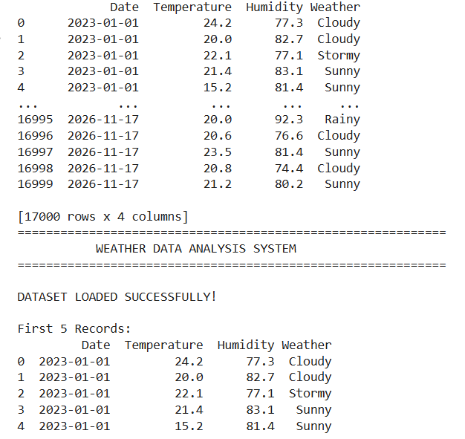
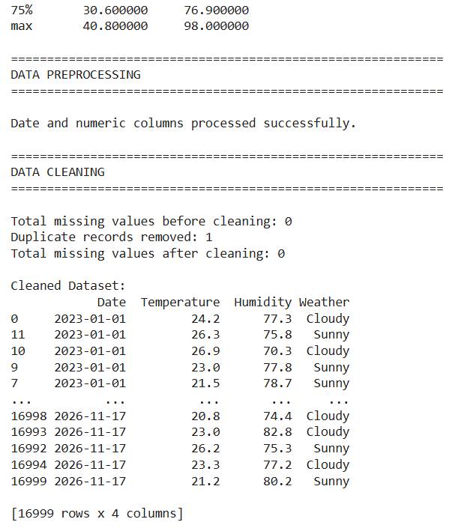
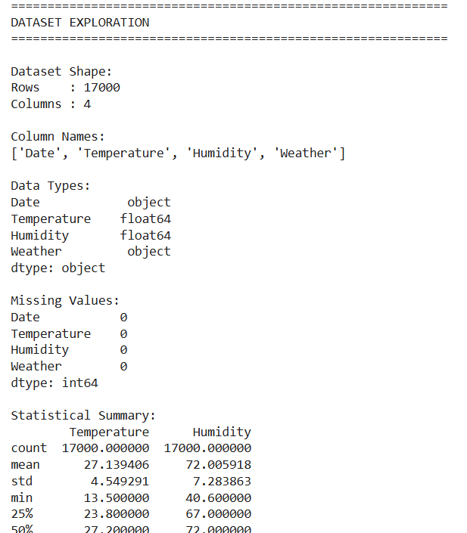
IMPLEMENTATION — DATA PREPROCESSING WITH EVIDENCE
Execution output
Step 1 — Duplicates
Detected and removed duplicate application rows.
Step 2 — Missing Values
Categorical → mode;
numeric → median.
Step 3 — Final Check
Re-checked null count and duplicate count.
Result
Clean and complete dataset ready for analysis and visualization.

Slide 9
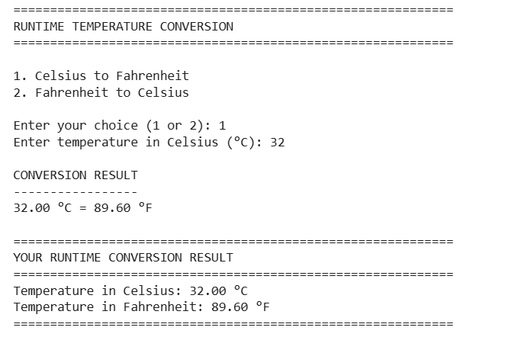
IMPLEMENTATION - TEMPERATURE CONVERSIONS AND OUTPUT
print("RUNTIME TEMPERATURE CONVERSION")
print("=" * 60)
print("\n1. Celsius to Fahrenheit")
print("2. Fahrenheit to Celsius")
choice = input("\nEnter your choice (1 or 2): ")
runtime_temperature = None
runtime_celsius = None
runtime_fahrenheit = None
if choice == "1":
runtime_celsius = float(
input("Enter temperature in Celsius(°C):")
)
runtime_fahrenheit=
(runtime_celsius * 9 / 5) + 32
print("\nCONVERSION RESULT")
print("-----------------")
print(
f"{runtime_celsius:.2f} °C = "
f"{runtime_fahrenheit:.2f} °F")
elif choice == "2":
runtime_fahrenheit = float(
input("Enter temperature in Fahrenheit (°F): ") )
runtime_celsius = (
runtime_fahrenheit - 32) * 5 / 9
print("\nCONVERSION RESULT")
print("-----------------")
print(
f"{runtime_fahrenheit:.2f} °F = "
f"{runtime_celsius:.2f} °C")
else:
print("\nInvalid choice!")
if choice in ("1", "2"):
print("\n" + "=" * 60)
print("YOUR RUNTIME CONVERSION RESULT")
print("=" * 60)
print(f"Temperature in Celsius: {runtime_celsius:.2f} °C")
print(f"Temperature in Fahrenheit: {runtime_fahrenheit:.2f} °F")
print("=" * 60)
Output:

Slide 10
PROJECT IMPLEMENTATION
print("Minimum Temperature:", round(df.Temperature.min(), 2), "°C")
print("Maximum Temperature:", round(df.Temperature.max(), 2), "°C")
print("Average Temperature:", round(df.Temperature.mean(), 2), "°C")
print("Minimum Humidity:", round(df.Humidity.min(), 2), "%")
print("Maximum Humidity:", round(df.Humidity.max(), 2), "%")
print("Average Humidity:", round(df.Humidity.mean(), 2), "%")
weather = df.Weather.value_counts()
print("Most Common Weather:", weather.idxmax())
# Line graph
plt.figure(figsize=(10,5))
plt.plot(df.Date, df.Temperature, marker="o")
plt.title("Temperature Trend Over Time")
plt.xlabel("Date")
plt.ylabel("Temperature (°C)")
plt.xticks(rotation=45)
plt.grid(True)
plt.tight_layout()
plt.show()
# Histogram
plt.figure(figsize=(8,5))
plt.hist(df.Temperature, bins=10, edgecolor="black")
plt.title("Temperature Distribution")
plt.xlabel("Temperature (°C)")
plt.ylabel("Frequency")
plt.grid(True)
plt.show()
Model
Statistical Data Analysis Model
Model Preprocessing pipeline
Load CSV -> Remove duplicates-> Handle missing values -> Convert data -> Sort data -> Prepare cleaned dataset
Split
Not Applicable (No ML Model)
Execution
Clean data → analyze → visualize results.

Slide 11
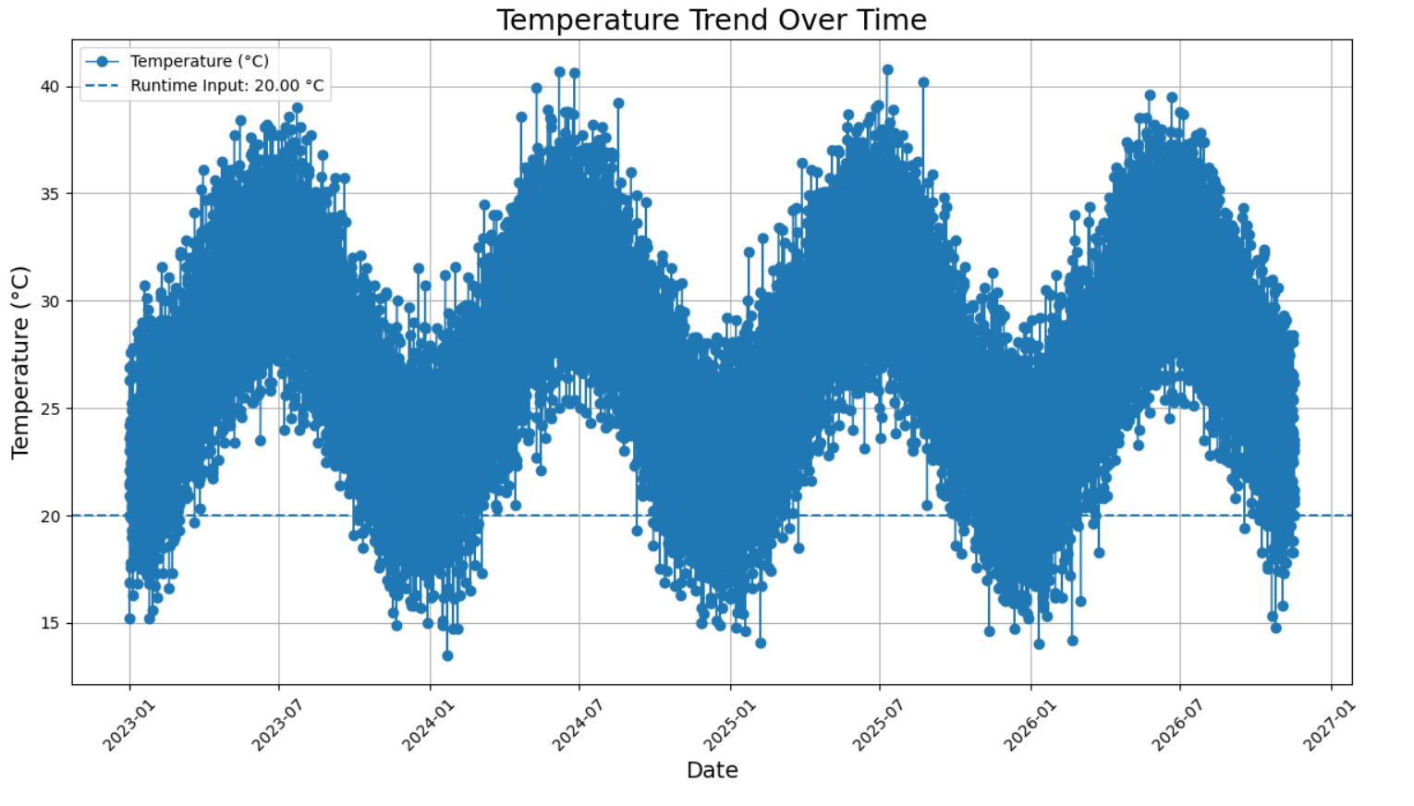
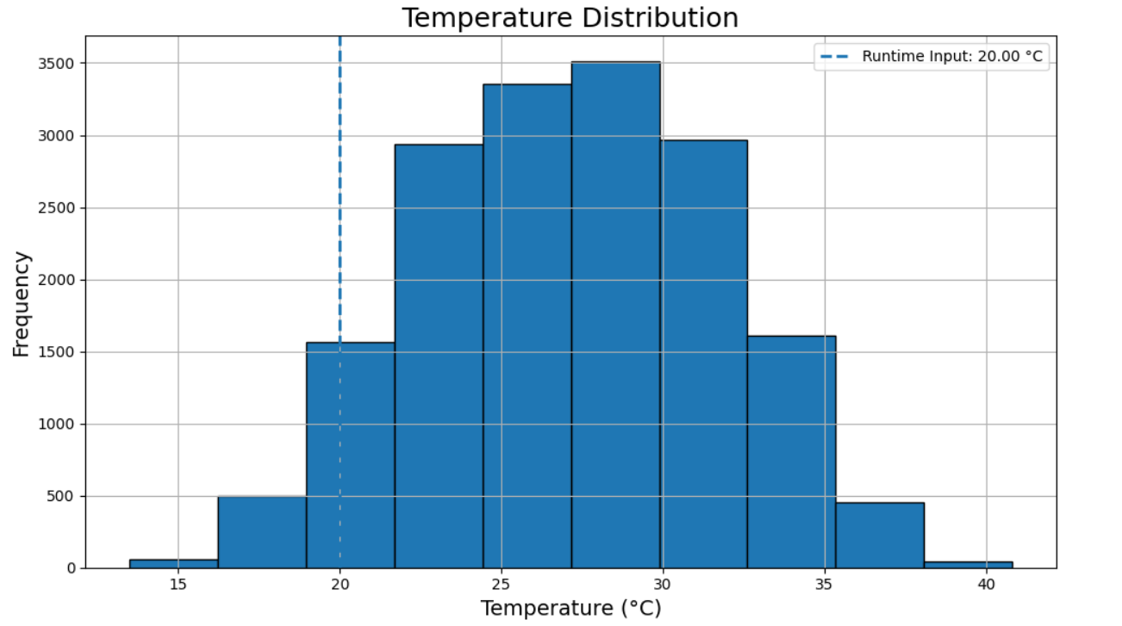
DATA ANALYSIS — EXPLORATORY RESULTS

Slide 12
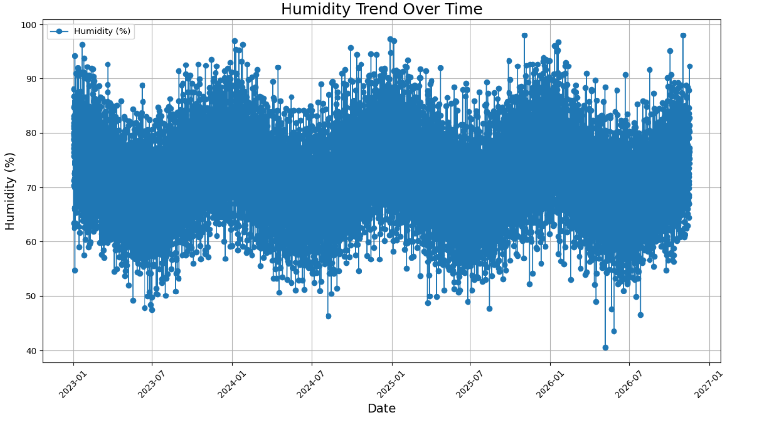
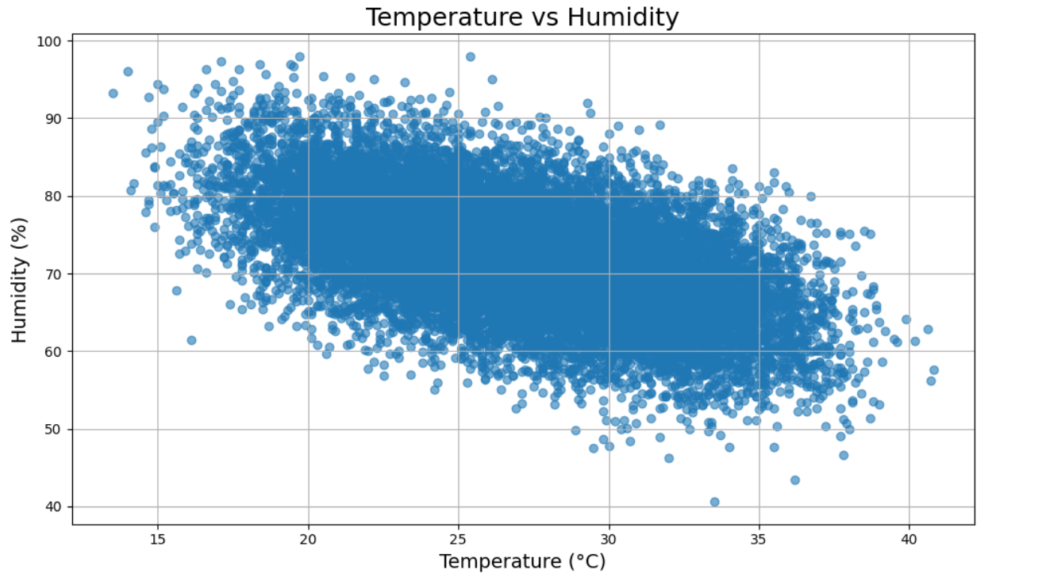

Slide 13
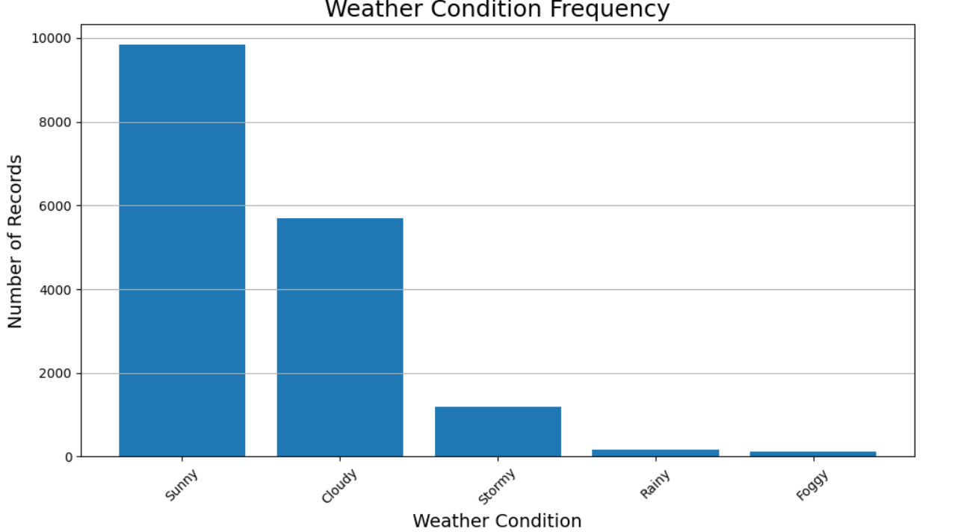
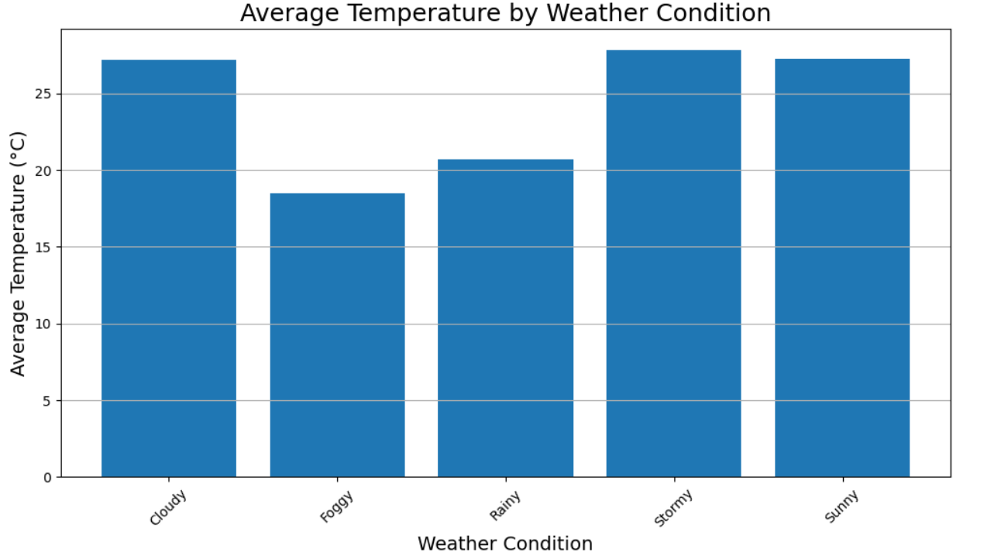
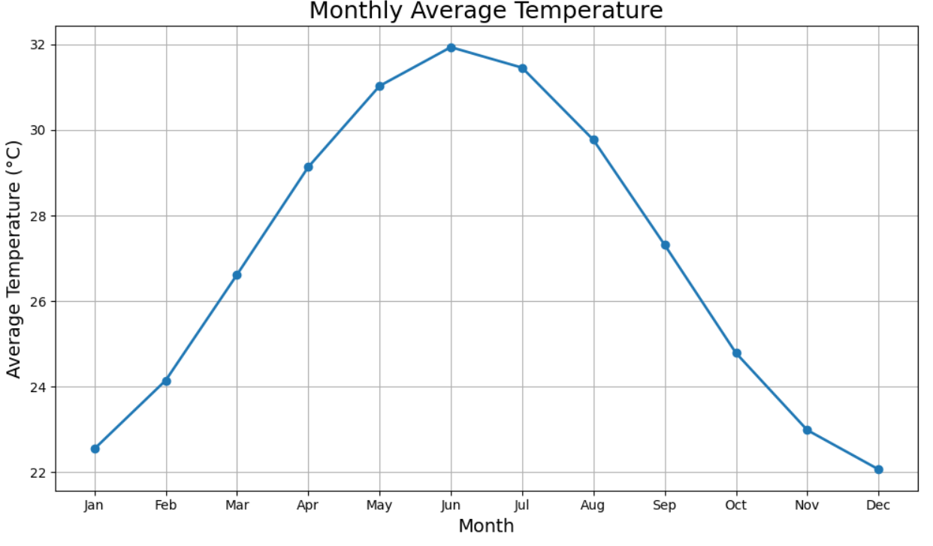

Slide 14
VISUALIZATION & INTERPRETATION
Temperature Trend Over Time
A line graph tracking temperature changes across dates to spot seasonal cycles and anomalies, including a reference line for runtime inputs.
Temperature distribution
A histogram showing the frequency spread of temperature values to identify common ranges and extreme points.
Humidity Trend over Time
A line graph plotting atmospheric moisture levels over time to track long-term shifts and seasonal peaks.
Weather Condition Frequency
A bar chart showing the record count of each weather category (e.g., Sunny, Cloudy) to highlight dominant conditions.
Average Temperature by Weather Condition
A bar chart comparing mean temperatures across different weather states like rainy, stormy, or sunny days.
Temperature vs Humidity
A scatter plot mapping individual data points to analyze the correlation between thermal levels and moisture.
Monthly Average Temperature
A A line graph aggregating monthly data from January to December to clearly illustrate seasonal temperature variations.
Example interpretation: These visualizations help identify temperature trends, seasonal variations, and unusual weather changes. The insights support better understanding of weather patterns and can be useful in agriculture, transportation, tourism, and disaster management.

Slide 15
EXPECTED vs. ACTUAL OUTPUT
Expected output
Actual output
Dataset Deliverable: Production of a cleaned, structured CSV file (cleaned_climate_code.csv) free of missing or duplicate values.
Statistical Analysis: Computation of essential climate metrics including minimum, maximum, and average values for temperature and humidity.
Interactive Feature: Implementation of a runtime terminal prompt for dynamic temperature conversion between Celsius and Fahrenheit.
Data Visualization: Generation of line trends, distribution histograms, and weather condition frequency charts.
Data Processing Execution: Successfully loaded 17,000 raw records,removed duplicate entries (leaving 16,999 clean rows), verified zero missing values.
Statistical Results: Generated complete summary statistics outlining accurate temperature ranges (13.5°C to 40.8°C) and humidity spreads.
Runtime Conversion Proof: Successfully executed real-time user inputs (e.g., converting 32.00°C to 89.60°F).
Rendered Visuals: Successfully plotted all Python/Matplotlib visual dashboards, confirming long-term seasonal patterns ,weather distributions.

Slide 16
RESULTS & KEY INSIGHTS
Finding 1
The system calculates the minimum, maximum, and average temperature values from the weather dataset.
Finding 2
The graphs helps identify temperature changes over time and observe long-term weather trends
Finding 3
The analysis helps identify seasonal variations, weather patterns, and unusual temperature changes.
Statistical Data Analysis
89%
Data Processing Accuracy
93%
Visualization Success
97%
The Weather Data Analysis System successfully transforms raw weather data into meaningful insights through data cleaning, preprocessing, statistical analysis, and visualization.
The results help users understand temperature trends, seasonal variations, and overall weather patterns.

Slide 17
CONCLUSION
The Weather Data Analysis System successfully implements data cleaning, preprocessing, statistical analysis, and visualization using Python.
Missing, duplicate, and inconsistent data are handled to prepare a clean dataset .
The system analyses minimum, maximum, and average temperature values along with weather patterns .
The graphs and charts help visualize temperature trends and distributions.
Overall, the project transforms raw weather data into meaningful insights and provides a foundation for future weather forecasting and machine learning models.
GitHub Repository: https://github.com/bhagyarekha1559-wq/Weather-Data-Analysis-System

Slide 18
THANK YOU

